Slide 1

AI-based pinch analysis and utility optimization for refinery energy network
Mentor: Prof. Senthilmurugan Subbiah

Slide 2
Project Objective
To investigate energy optimization strategies in refinery operations and build an intelligent tool that automates pinch analysis for efficient resource management.
Develop a semi-automated system that can:
Understand and extract energy loops from PFDs and P&IDs.
Perform pinch analysis with minimal expert intervention.
Leverage LLMs and object-oriented machine learning for automation

Slide 3
Workflow overview of pinch analysis
LLM-Based Automation
PFDs, P&IDs and DCS Data
Heat Exchangers Loop Detection
Data Extraction (tags, streams, exchangers, P&IDs)
Pinch Analysis Engine
Results – Report of Pinch Analysis

Slide 4
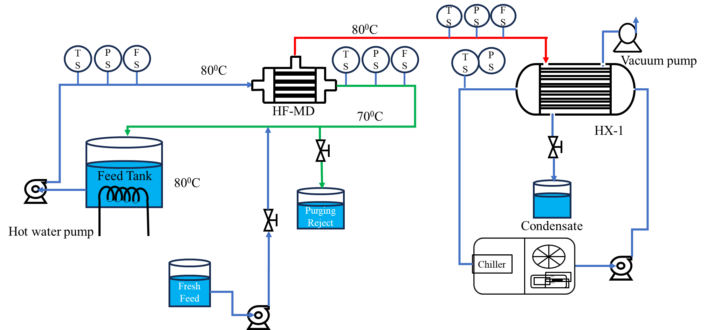
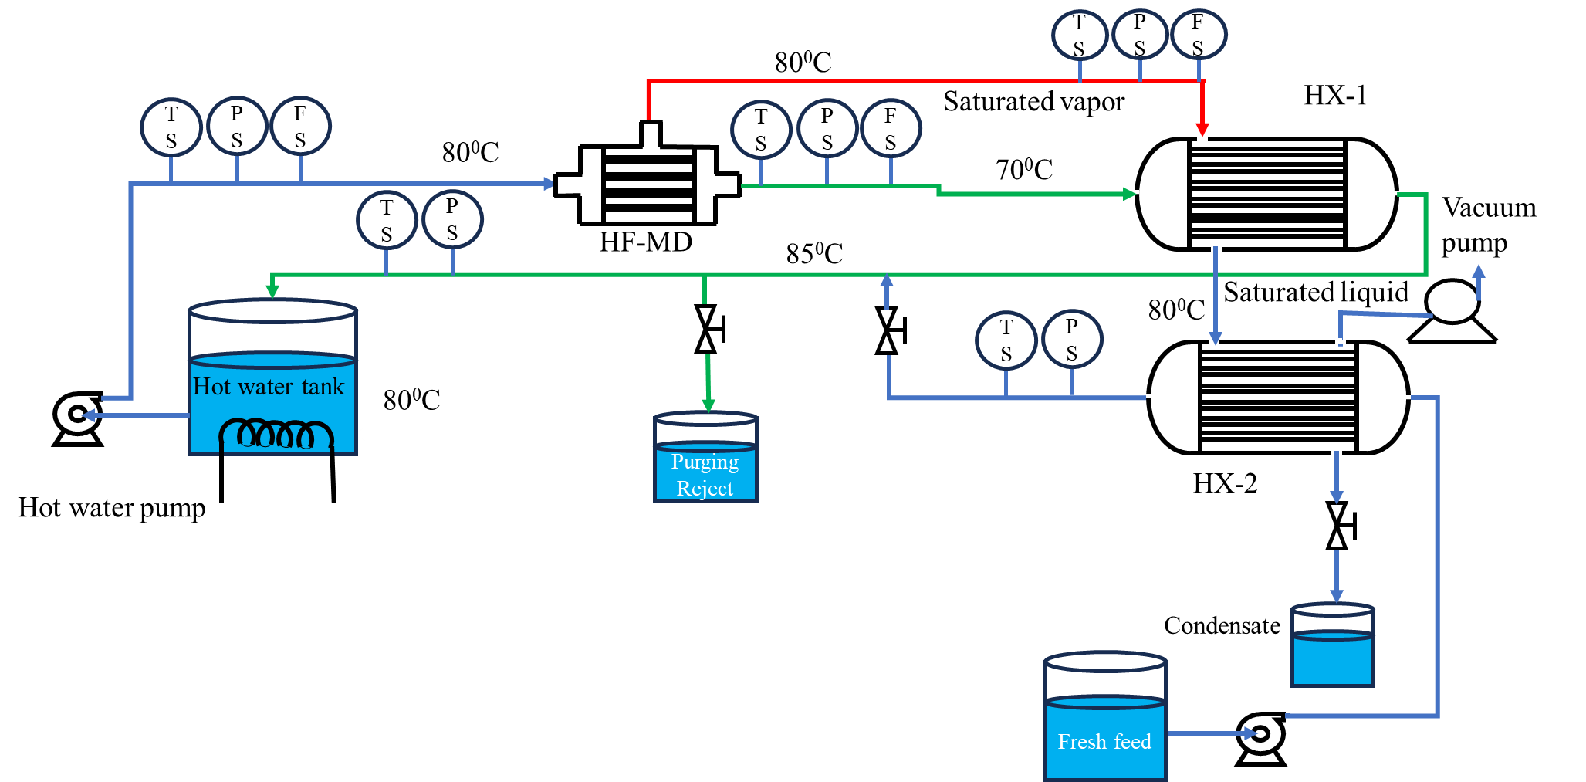
Methods for Energy Optimization
Case 1
VMD without energy recovery unit
Case 2
VMD integrated with heat exchanger unit

Slide 5
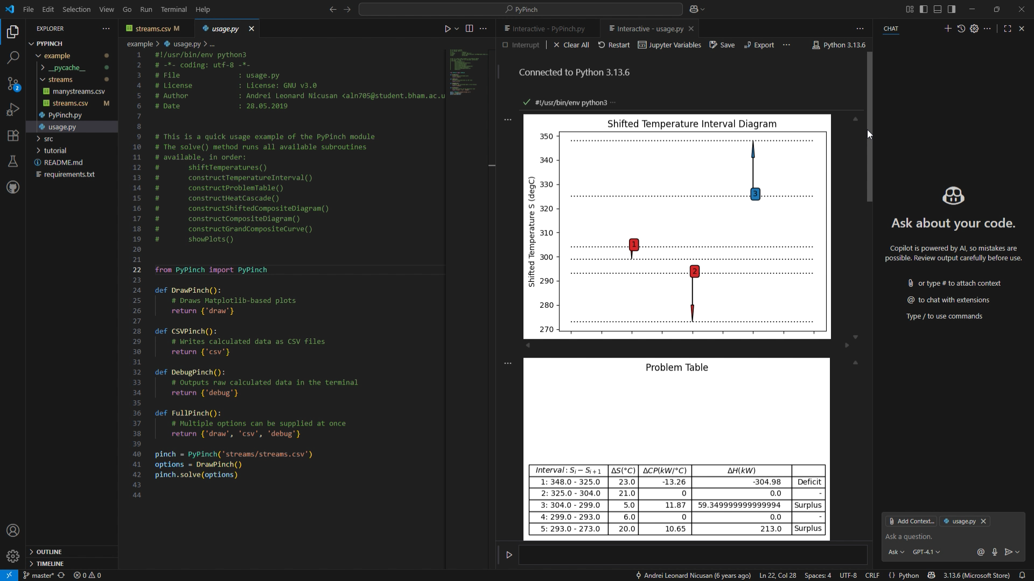

Project Progress
Collaborated with a refinery for data
Heat loops extraction from PFD and P&IDs
Pinch analysis calculation automation
Pinch analysis automation
We’re currently developing algorithm for this

Slide 6

Thank You
Presented by:
Ankit Kumar Singh
Yoshita Banerjee
Hemal Vadaliya
Bishan Kumar Deka

